Slide 1
Interfacing WordNet with DOLCE: towards OntoWordNet
(Guarino et al., 2010)

Slide 2
Outline
3.1 Introduction
3.2 WordNet’s main problems
3.3 The DOLCE upper ontology
3.4 Mapping WordNet into DOLCE

Slide 3
Parthood
the relation between the whole and its parts
life vs. person (temporal part vs. non-)

Slide 4
3.2 WordNet’s main problems
Confusing concept and individual
Confusing object-level and metalevel
OntoClean constraint violation
Heterogenous level of generality

Slide 5
1. Confusing concept and individual
{event}:
{fall} (instance!)
{social event} (class)
{miracle} (class)

Slide 6
2. Confusing object-level and metalevel
{abstraction}:
{set}
{time}
{space}
{attribute}
{relation}

Slide 7
3. OntoClean constraint voilation
P subsumes Q → all instances of Q are also instances of P
type vs. role
{causal agent} (role)
{person} (type)
{germicide} (role)
{vasoconstrictor} (role)
{antifungal} (role)

Slide 8
4. Heterogeneous levels of generality
{entity}:
{physical object}
agentive physical object (person), non-(house)
{subject}
n/a

Slide 9
Outline
3.1 Introduction
3.2 WordNet’s main problems
3.3 The DOLCE upper ontology
3.3.1 Basic choices
3.3.2 The top categories
3.3.3 Further distinctions
3.4 Mapping WordNet into DOLCE

Slide 10
3.3.1 Basic choices
Descriptive Ontology for Linguistic and Cognitive Engineering
to negotiate meaning (labelled link)
cognitive orientation (not for truth)
an ontology of particular (upper w/o instance)
multiplicative approach:
different entities can be co-located in the same space-time (vase vs. clay)

Slide 11
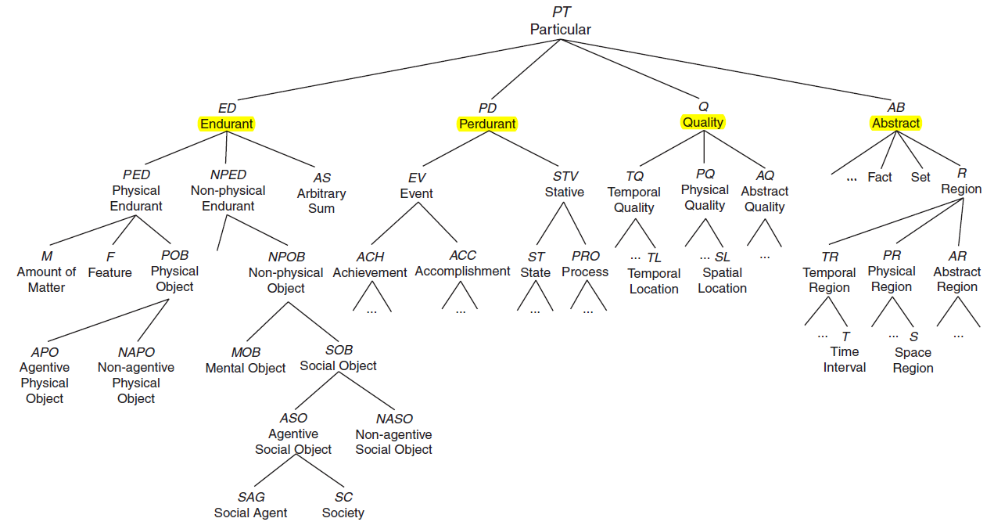

Slide 12
3.3.2 Four top categories
Endurant (e.g., person)
no temporal part
wholly present at any time they are present
Perdurant (e.g., life)
accumulated by temporal parts
partially present at any time they are present

Slide 13
Quality inheres to entities
The rose turned from red to brown.
Red is opposite to green.
Quale is the position of a quality within a quality space
Abstract has no spatial or temporal quality

Slide 14
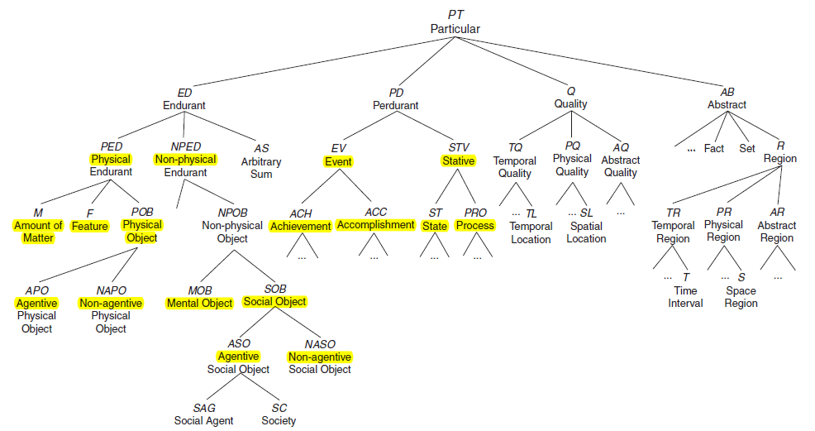

Slide 15
3.3.3 Further distinctions
Unity
an instance of being ocean is a whole entity
an instance of being water is arbitrary scattered
Physical Object, Feature (+U)
Amount of Matter (~U)
legal agent (-U)
Dependent
Physical Objects are not dependent on other objects
Features are dependent on physical objects (hosts)

Slide 16
Agentive
Agentive Physical Object with intention, belief, desire
Non-Agentive Physical Object without …
Agentive Social Object (student, university)
Social Agent constitutes Society
Non-Agentive Social Object (law, norm ,share, circuit)
Non-Physical Object
Social Object
Mental Object (private experience)

Slide 17
cumulative
Stative is cumulative (e.g., sitting, running)
Event is not cumulative (e.g., reach, built)
homeomeric
(temporal) part ~ whole
State is homeomeric (e.g., sitting)
Process is not homeomeric (e.g., running)
atomic
Achievement is atomic (e.g., reach)
Accomplishment is not atomic (e.g., built)

Slide 18
3.4 Mapping WordNet into DOLCE
{group}:
Agentive Physical Object {citizenry}
NAPO {biological group} {kindom} {collection}
Agentive Social Object {social group}
NASO {circuit}

Slide 19
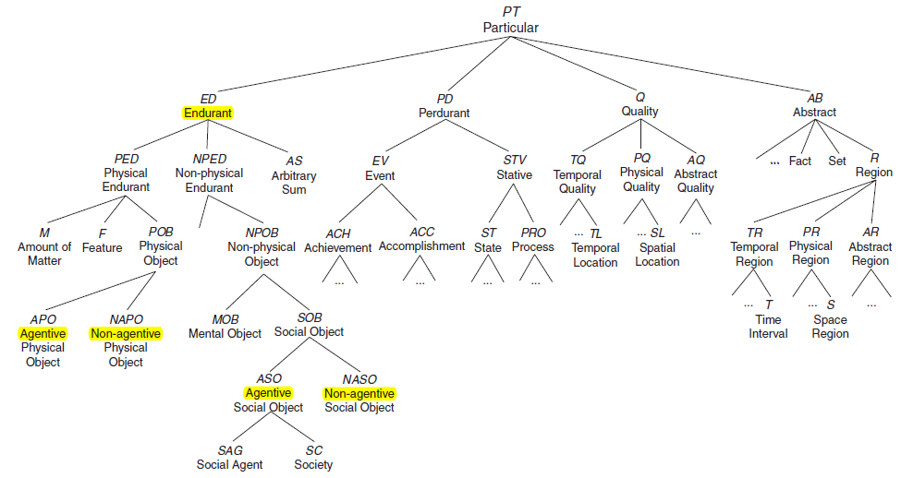

Slide 20
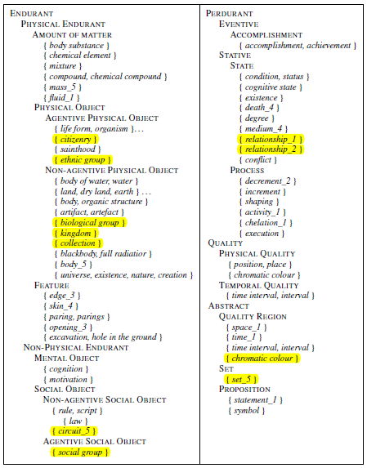

Slide 21
OntoWordNet
Re-engineering WordNet lexicon as a formal ontology
to distinguish synsets that can be formalized as classes from individuals
to interpret lexicon relations from WordNet as ontological relations
Aligning WordNet’s top-level to the ontology
Consistency check of the overall result
Learning and revising formal domain relations

Slide 22
OntoClean
Assigning Meta-Property (I, U, R)
Analyzing Rigid Property
(+R, check constraint violation)
Analyzing Non-Rigid Property

Slide 23
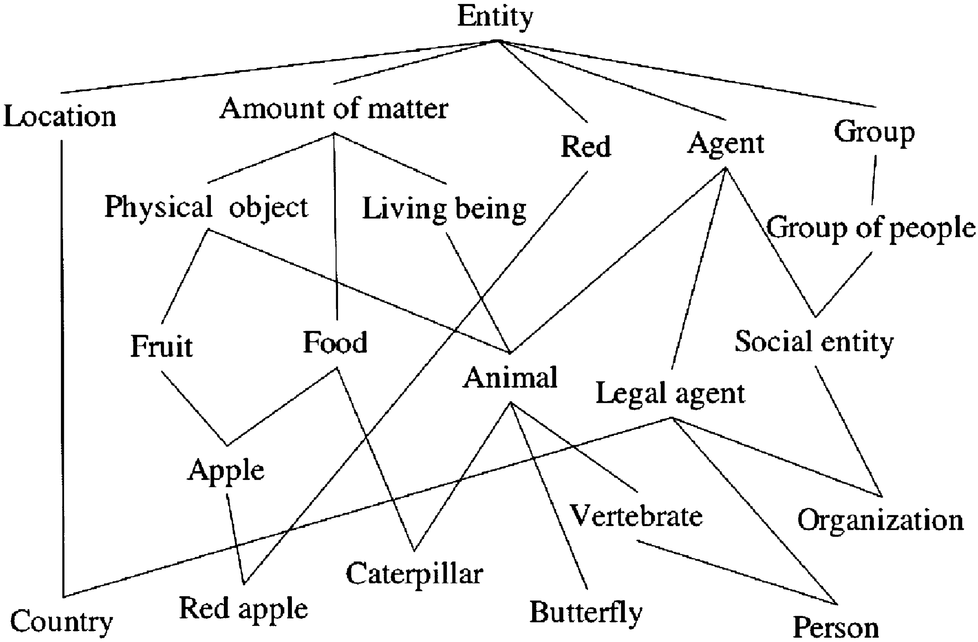

Slide 24
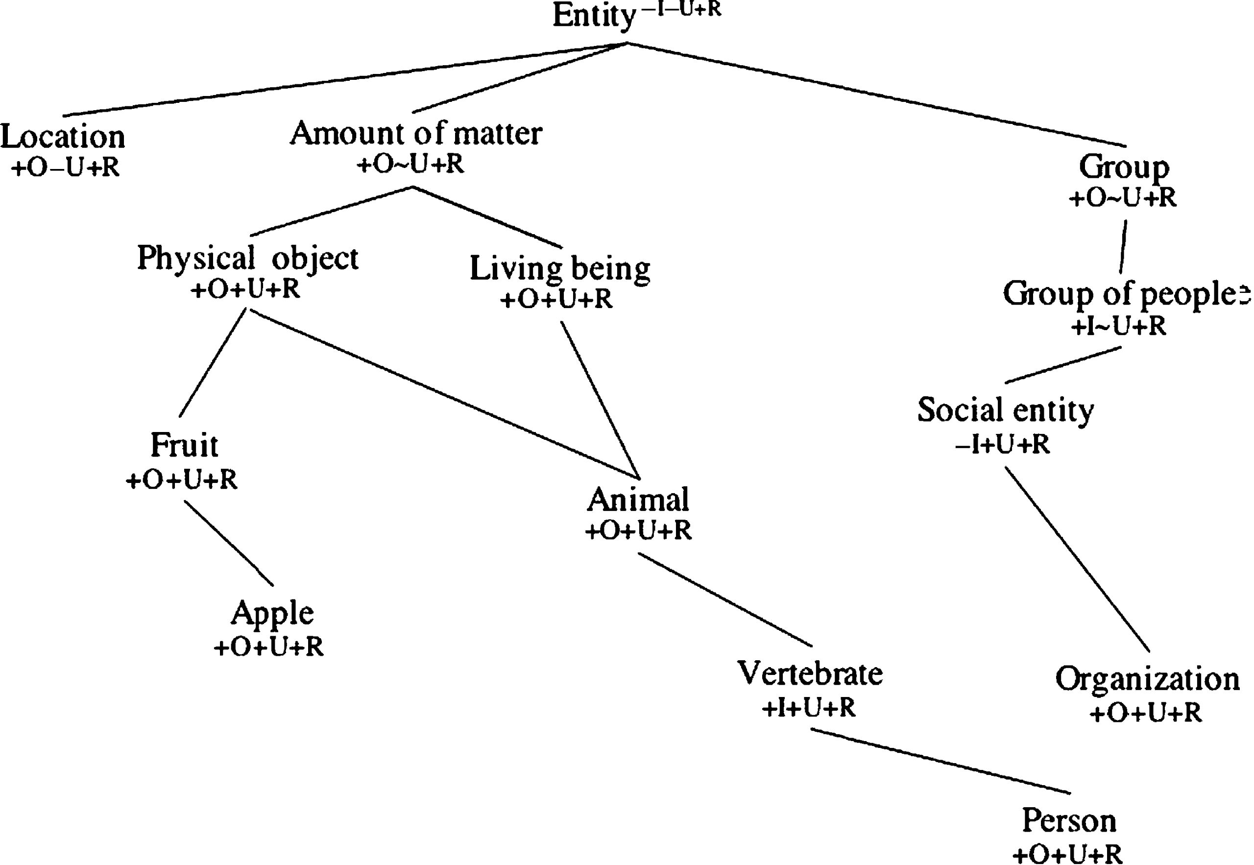
1. Assigning Meta-Property (I, U, R)

Slide 25
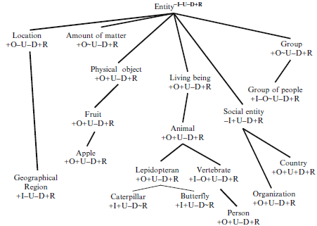
2. Analyzing Rigid Property

Slide 26
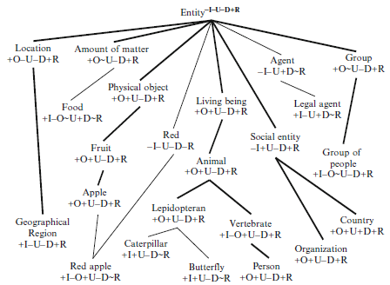
3. Analyzing Non-Rigid Property

Slide 27
3.5 Conclusion
The result of OntoWordNet
performance of application
difference maximization?

Slide 28
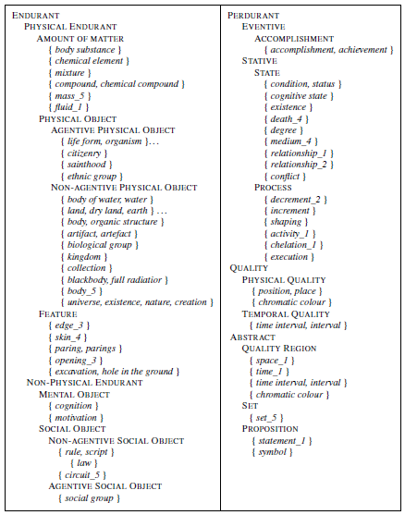

Slide 29
Parthood
the relation between the whole and its parts
life vs. person (temporal part vs. non-)
sitting vs. achievement (cumulative vs. non-)
achievement vs. accomplishment (atomic vs. non-atomic)

Slide 30
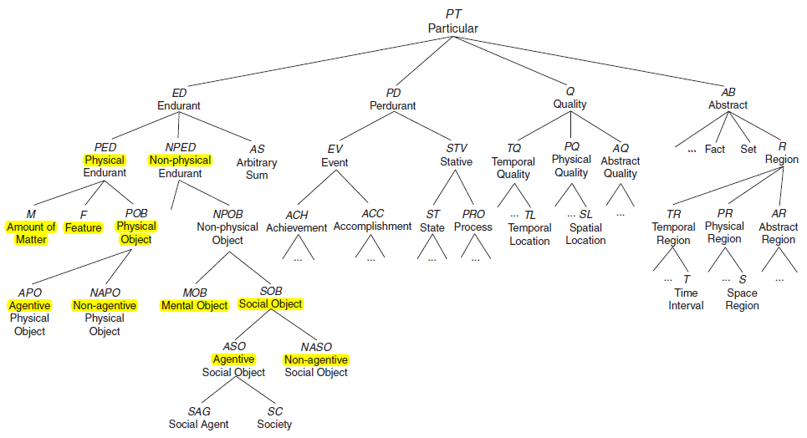

Slide 31
